Slide 1

PROJECT 3
Storytelling With Data
Note: Analysis Done from Data given by udacity
By: Saksham Taneja

Slide 2
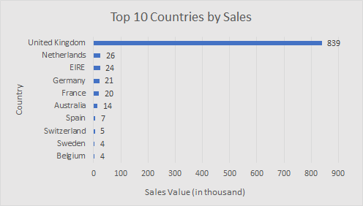
ORIGNAL
ORIGINAL GRAPH

Slide 3
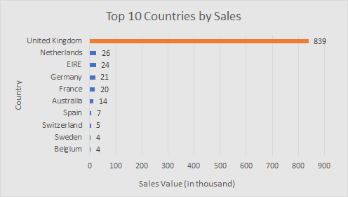
Best Performing Country in Sale Value
The top best performing country as per sale valus is UK (united Kingdom)
United Kingdom is having sale on 1st number with sale value of 836 thousand
United Kingdom > Netherland > 0
Difference between the range of sale value is 100
Graph has shown top 10 country who has performed best sale

Slide 4

The Second Best Performing Country in Sale Value
The second top best performing country as per sale valus is netherlands
Netherlands is having sale on 2st number with sale value of 26 thousand
Netherland > EIRE > 0
Difference between the range of sale value is 100
Graph has shown top 10 country who has performed best sale

Slide 5

The Third Best Performing Country in Sale Value
The third top best performing country as per sale valus is EIRE
EIRE is having sale on 1st number with sale value of 24 thousand
EIRE> Germany > 0
Difference between the range of sale value is 100
Graph has shown top 10 country who has performed best sale

